Slide 1
Chapter 2
Management Theory

Slide 2

Peter Drucker
“The best way to predict the future is to create it.” … Peter Drucker
Peter Drucker – the creator and inventor of modern management.

Slide 3
Drucker’s beliefs
Workers should be treated as assets
The corporation could be considered a human community
There is no business without the customer

Slide 4
Evidence-based management
Translating principles based on best evidence into organizational practice, bringing rationality to the decision-making process.

Slide 5
Two overarching perspectives about management
Historical
  Classical
  Behavioral
  Quantitative
Contemporary
  Systems
  Contingency
  Quality management

Slide 6
Classical Viewpoint of Management
Emphasizes finding ways to manage work more efficiently.
Two Branches: scientific and administrative

Slide 7
Scientific Management
Emphasizes the scientific study of work methods to improve the productivity of individual workers.
    Frederick W. Taylor – the father of scientific management

Slide 8
Scientific Management
Evaluate a task by scientifically studying each part of the task
Carefully select workers with the right abilities for the task
Give workers the training and incentives to do the task with the proper work methods
Use scientific principles to plan the work methods and ease the way for workers to do their jobs

Slide 9
Administrative Management
Concerned with managing the entire organization
        A well defined hierarchy of authority
        Formal rules and procedures
        A clear division of labor
        Impersonality
        Careers based on merit

Slide 10
Henri Fayol
Fayol was not the first to investigate management behavior, but he was the first to systemize it.
Fayol was the first to identify the major functions of management:
  Planning
  Organizing
  Leading
  Controlling

Slide 11

Examples of Classical Viewpoint
(often seen as mechanical – not always taking into account human needs)
      Pizza Hut
      McDonalds

Slide 12
Behavioral Viewpoint
Emphasizes the importance of understanding human behavior and of motivating employees toward achievement.
      Organizations should be operated as “communities” with managers and subordinates working together in harmony
      Conflicts should be resolved by having managers and workers talk it out.
      The work process should be under the control of workers with relevant knowledge rather than of managers who should act as facilitators

Slide 13
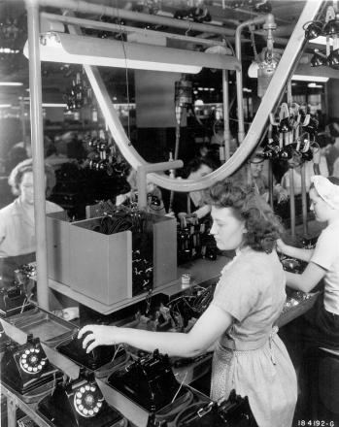

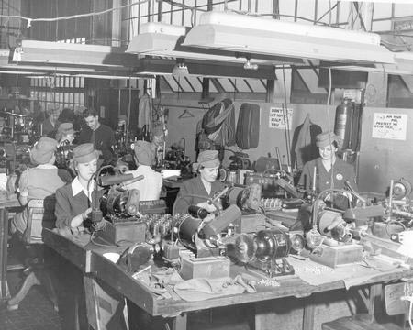
Hawthorne Effect
Employees worked harder if they received added attention, if they thought that managers cared about their welfare and that supervisors paid special attention to them.

Slide 14
Human Relations Movement
Proposes that better human relations could increase worker productivity
  Theorists
        Abraham Maslaw
        Douglas McGregor

Slide 15
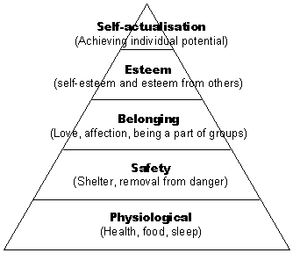
Abraham Maslow
Hierarchy of Needs

Slide 16
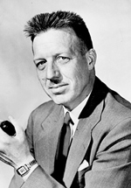
Douglas McGregor
Theory X and Y
      X = pessimistic, negative view of workers (workers are irresponsible, unresponsive to change, lack ambition, hate work)
      Y = optimistic, positive view of workers (workers are capable of accepting responsibility, self-direction, and self-control and of being imaginative and creative)

Slide 17
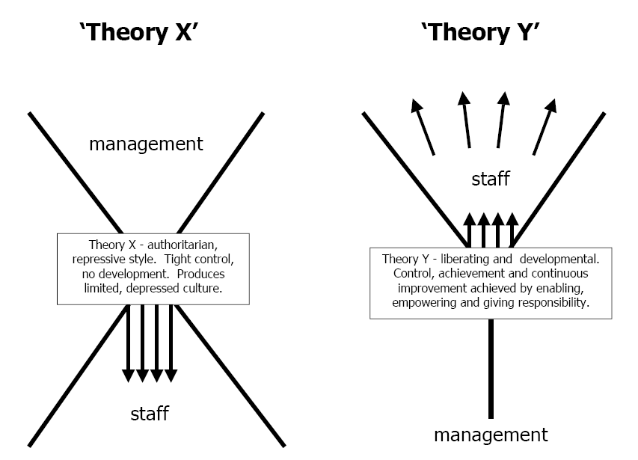

Slide 18
Behavioral Science
Relies on scientific research for developing theories about human behavior that can be used to provide practical tools for managers.
    Psychology
    Sociology
    Anthropology
    Economics

Slide 19

Quantitative Management
The application to management of quantitative techniques, such as statistics and computer simulations.
Two branches
  management science
  operations management

Slide 20
Management Science
Focuses on using mathematics to aid in problem solving and decision making.
  Rational, science-based techniques and mathematical models to improve decision making and strategic planning

Slide 21
Operations Management
Focuses on managing the production and delivery of an organization’s products or services more effectively.
  Concerned with work scheduling, production planning, facilities location and design, and decisions about the optimum levels of inventory a company should maintain

Slide 22
Contemporary Perspective on Management
Systems
Contingency
Quality Management

Slide 23

Systems Viewpoint
Regards the organization as a system of interrelated parts.
    A collection of subsystems

Slide 24
The Four Parts of A System
Inputs – the people, money, information, equipment, and materials required to produce an organization’s goods or services.
Outputs – the products, services, profits, losses, employee satisfaction or discontent, and the like that are produced by the organization
Transformation Process – the organization’s capabilities in management and technology that are applied to converting inputs into outputs
Feedback – information about the reaction of the environment to the outputs that affects the inputs

Slide 25
Complexity Theory
The study of how order and pattern arise from very complicated, apparently chaotic systems.

Slide 26

Open vs Closed Systems
Open System – continually interacts with its environment
Closed System – has little interaction with its environment
Open system looks to feedback for improvements in the future

Slide 27
Contingency Viewpoint
Emphasizes that a manger’s approach should vary according to (be contingent on) the individual and the environmental situation.
It addresses problems on a case- by-case basis and varied the solution accordingly

Slide 28
Quality-Management Viewpoint
Includes quality control, quality assurance, and total quality management (TQM).
Quality refers to the total ability of a product or service to meet customer needs

Slide 29
Quality – refers to the total ability of a product or service to meet customer needs.
Quality Control – the strategy for minimizing errors by managing each stage of production.
Quality Assurance – focuses on the performance of workers, urging employees ti strive for “zero defects.”

Slide 30
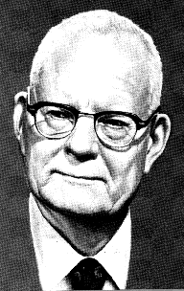
W. Edwards Deming
Best known for his work in Japan
There, from 1950 onward, he taught top management how to improve design (and thus service), product quality, testing and sales

Slide 31

Total Quality Management
(TQ M)
A comprehensive approach – led by top management and supported throughout the organization – dedicated to continuous quality improvement.

Slide 32

Four components of TQM
Make continuous improvement a priority.
Get every employee involved.
Listen to and learn from customers and employees.
Use accurate standards to identify and eliminate problems.

Slide 33

Learning Organization
An organization that actively creates, acquires, and transfers knowledge within itself and is able to modify its behavior to reflect new knowledge.
    Create and acquire knowledge
    Transfer knowledge
    Modify behavior

